Slide 1
Diabetes Mellitus in Children
Prof. Asvini D Fernando
Department of Paediatrics

Slide 2
Diabetes Mellitus
A chronic metabolic disorder characterized by hyperglycaemia as a cardinal biochemical feature, caused by deficiency of insulin or its action, manifested by abnormal metabolism of carbohydrates, protein and fats

Slide 3
Type 1 Diabetes
Most common endocrine metabolic disorder of childhood and adolescence
Aetiology: genetic predisposition and environmental precipitants play a role
Genes: Susceptibility - HLA-DR3 and / or DR4
Environment : Viral infections, dietary factors, chemicals
Autoimmune process damages the pancreatic β-cells absolute insulin deficiency
Markers of β-cell destruction include islet cell antibodies and antibodies to glutamic acid decarboxylase (GAD). Association with other autoimmune disorders - hypothyroidism.

Slide 4
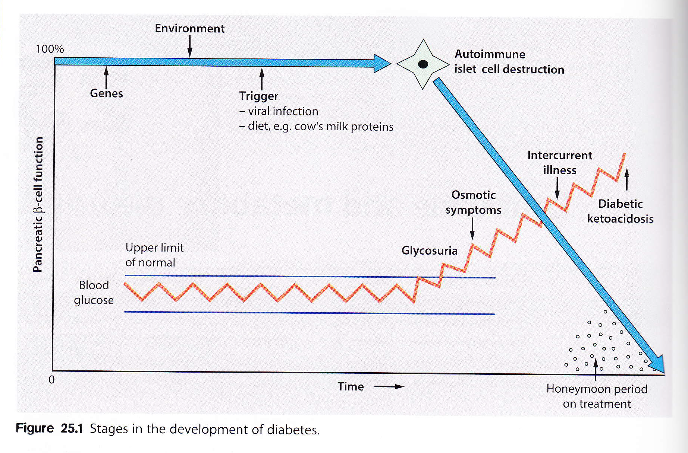

Slide 5
Epidemiology
Incidence of type 1 diabetes is rising globally
It is being diagnosed at a younger age
2 peaks -one in the preschool group , other pubertal group.
Notes:
Incidence of type 1 diabetes rising by 2-5% per annum
Type I diabetes being diagnosed at younger ages; greatest rise in under 4 yr old¹
Estimated number of children (1-14 years) with type 1 DM in 2006 was 440,000.
Incidence is extremely variable
Increase in incidence steeper in low-prevalence
Increase not explained by shifts in genetic susceptibility

Slide 6
Classification of diabetes
The major forms of diabetes are differentiated by insulin deficiency vs insulin resistance
Type 1 The commonest type in childhood
Insulin-dependent results from deficiency of insulin secretion because of pancreatic β-cell damage
Type 2
Non-insulin-dependent Usually older children, obesity-related, positive family history, not prone to ketosis, commoner in some ethnic groups

Slide 7
Classification of diabetes
Type 3 Other specific types
Genetic defects in β-cell function (maturity-onset diabetes of the young, MODY)
Infections, e.g. congenital rubella
Drugs, e.g. corticosteroids
Pancreatic exocrine insufficiency, e.g. cystic fibrosis
Endocrine diseases, e.g. Cushing's syndrome
Genetic/chromosomal syndromes, e.g. Down syndrome and Turner syndrome
Type 4 Gestational diabetes

Slide 8
Type 1 Diabetes Mellitus
Formerly called insulin-dependent diabetes mellitus (IDDM) or juvenile diabetes,
low or absent levels of endogenously produced insulin due to autoimmune destruction of pancreatic cells
dependence on exogenous insulin to prevent ketoacidosis

Slide 9
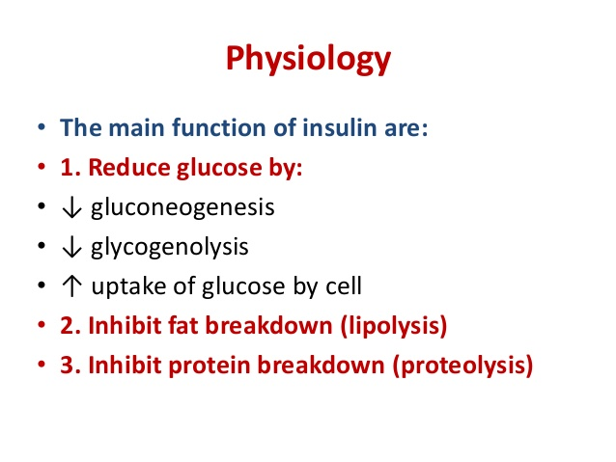
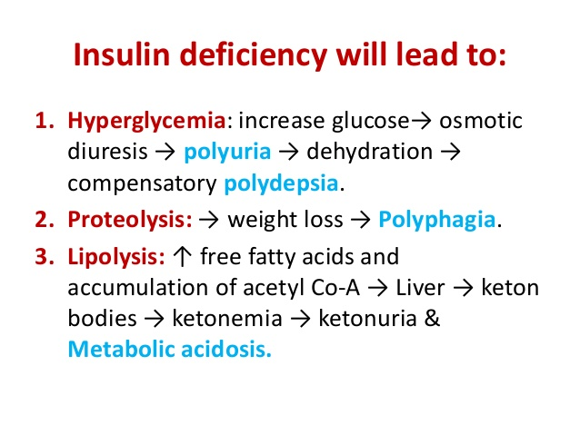

Slide 10
Type 1 Diabetes Pathophysiology
Insulin deficiency
Hyperglycaemia
Osmotic diuresis (when renal threshold of 10mmol/l is exceeded)
Loss of calories, electrolytes; dehydration
Hyper secretion of stress hormones
Impairs insulin secretion, antagonizes its action, promotes glycogenolysis, gluconeogenesis,
lipolysis excess free fatty acids ketogenesis

Slide 11
Presentation
Triad of classic symptoms
3
Polyuria
Polydypsia
Weight loss despite a very good appetite (polyphagia)

Slide 12
Presentation
Less common:
Enuresis (secondary) Skin sepsis Candida and other infections
Late presentation- diabetic ketoacidosis Smell of acetone in breath vomiting, dehydration, abdominal pain, hyperventilation due to acidosis (Kussmaul breathing), hypovolaemic shock, drowsiness and coma

Slide 13
Diagnostic criteria
Biochemical evidence
Fasting blood sugar ≥ 7.0 mmol/l (126mg/dl)
Random blood sugar ≥ 11.1 mmol/l (200mg/dl)
2-hour plasma glucose during Oral Glucose Tolerance Test (OGTT) ≥ 11.1 mmol/l (rarely done in children)

Slide 14
Diagnostic criteria
Symptoms
+
1 of biochemical
If asymptomatic:
2 biochemical
Other clinical features
Nocturnal enuresis
Vaginal Candidiasis

Slide 15
Diabetic ketoacidosis (DKA)
Clinical signs
Dehydration
Deep sighing respiration (Kussmaul breathing)
Smell of ketones
Lethargy, drowsiness
Abdominal pain
Biochemical
Ketones in blood / urine (Rothera test)
Blood glucose > 11.1 mmol/l or > 200 mg/dl
Acidaemia pH<7.3 or bicarbonate < 15 mmol/l (arterial blood gas)

Slide 16
Diabetic ketoacidosis (DKA)
Children can die from DKA
Emergency management
Air way - airway, NG
Breathing - 100% oxygen
Circulation – if shocked 10ml/kg bolus of 0.9% saline, up to 30ml/kg
Full assessment
Degree of dehydration
Level of consciousness

Slide 17
Degree of dehydration
Mild 3% --only just clinically detectable
Moderate 5%– dry mucous membranes and reduced skin turgor
Severe 8%-- those above + sunken eyes, poor capillary return
Shock-poor perfusion, rapid thready pulse, hypotension

Slide 18
Diabetic ketoacidosis (DKA)
Investigations - assessing severity
Blood glucose
Urea, electrolytes, creatinine
Blood gas
Haemoglobin and packed cell volume
Urine glucose and ketones
Investigations – establishing cause
Blood and urine cultures
Chest X-ray
Leucocytosis is a feature of DKA
Fever – not part of DKA

Slide 19
Diabetic ketoacidosis
THREE 3 pronged management
1. Fluids
2. Insulin
3. Treat underlying cause

Slide 20
DKA management
Correct dehydration
If <5% - oral fluids; if >5% - intravenous
If IV - Correct over 48 hours
- Initially 0.9% saline
- Add KCl 20mmol to every 500ml (if urine output is satisfactory
Insulin
Soluble
IV if dehydration>5%
0.1unit/kg/hour
When blood glucose <12mmol/l
0.45% saline+5% dextrose
Insulin 0.05units/kg/hr if pH>7.3
Treat underlying cause
E.g. Sepsis

Slide 21
Diabetic Ketoacidosis
Once child has clinically improved and blood ketones are less than 1.0 mmol/l commence subcutaneous Insulin
To prevent hyperglycaemia commence S.C Insulin 1 hour before stopping soluble Insulin infusion
Total daily dose of SC Insulin 0.75-1.0 u/kg in pre-pubertal child and 1-1.2 u/kg in the pubertal group

Slide 22
DKA observations
Blood glucose - hourly
Neurological state hourly
headache, irritability, drowsiness
slowing heart rate, rising BP
Glasgow coma scale (level of consciousness)
Hourly fluid input-output
Electrolytes and lab glucose 2 hours after start of IV therapy, then 4 hourly

Slide 23
DKA problems
Cerebral oedema
Senior staff / PICU
Mannitol
Restrict IV fluids
Intubate and ventilate (keep pCO₂ <3.5kPa)
Hypoglycaemia and hypokalaemia
Aspiration pneumonia
NaHCO₃ to be given only if pH<6.9

Slide 24
Type 1 diabetes – Management goals
Control of blood sugar
Prevent acute complications
Ensure optimal growth and development
Maintain normal lifestyle
Educate of parents / patient / teachers
Provision of psychological support
Regular screening and early intervention for long term complications
Notes:
Control of blood sugar – close to normoglycaemia
Prevent acute complications
Ensure optimal growth and development
Maintain normal lifestyle
Adequate education of parents and patient
Provision of psychological support
Access to appropriate social support
Reduce long term complications / regular screening and early intervention
Early detection and treatment of associated diseases
No readmissions due to type 1 diabetes
Control of blood sugar – close to normoglycaemia
Prevent acute complications
Ensure optimal growth and development
Maintain normal lifestyle
Adequate education of parents and patient
Provision of psychological support
Access to appropriate social support
Reduce long term complications / regular screening and early intervention
Early detection and treatment of associated diseases
No readmissions due to type 1 diabetes
Control of blood sugar – close to normoglycaemia
Prevent acute complications
Ensure optimal growth and development
Maintain normal lifestyle
Adequate education of parents and patient
Provision of psychological support
Access to appropriate social support
Reduce long term complications / regular screening and early intervention
Early detection and treatment of associated diseases
No readmissions due to type 1 diabetes
Control of blood sugar – close to normoglycaemia
Prevent acute complications
Ensure optimal growth and development
Maintain normal lifestyle
Adequate education of parents and patient
Provision of psychological support
Access to appropriate social support
Reduce long term complications / regular screening and early intervention
Early detection and treatment of associated diseases
No readmissions due to type 1 diabetes

Slide 25
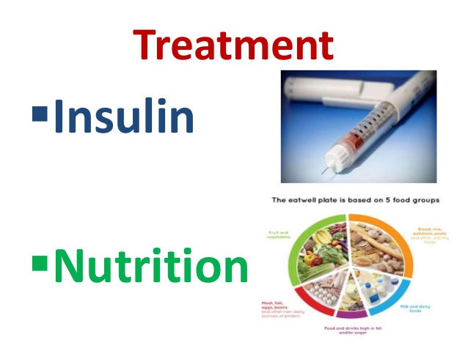

Management
Exercise

Slide 26
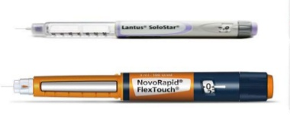
Type 1 diabetes – Insulin therapy
Insulin injections daily for life
Bovine and porcine forms, risk of:
Insulin allergy
Insulin resistance by antibody formation
Human insulin (recombinant DNA)
More expensive
No allergy / resistance
Notes:
Insulin injections daily for life
Oral hypoglycaemics have no role in type 1 diabetes mellitus
Insulin discovered in 1922
Pure form from bovine and porcine sources in 1926
Commercial synthesised human insulin by recombinant DNA technology from 1980s

Slide 27
Insulin therapy
Usually administered subcutaneously
Absorption varies according to site
Do not inject to an area going to be exercised
Rotation of injection sites is important Lipoatrophy in the subcutaneous tissues because of repeated injection of insulin at the same site. Same site less painful therefore children prefer it Rotation of sites will prevent
Lipohypertrophy – abnormal collection of fat under the skin

Slide 28
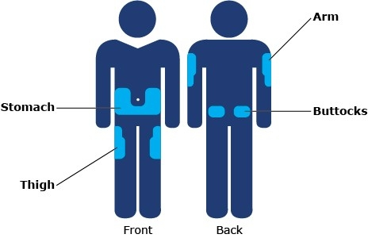
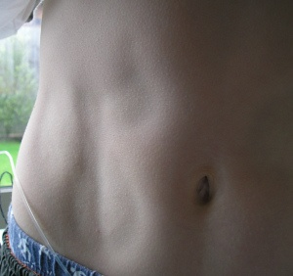
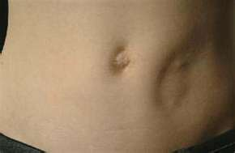
Lipoatrophy

Slide 29
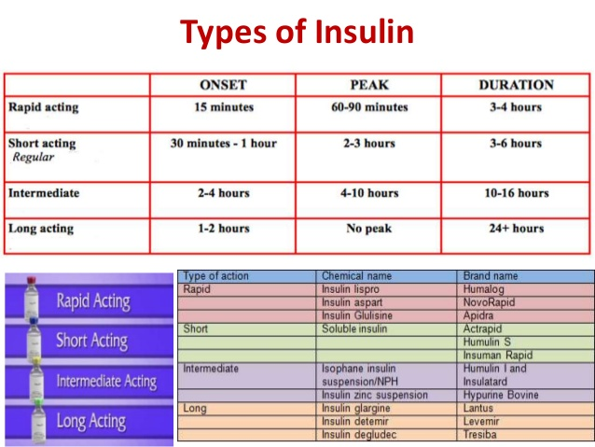

Slide 31
Insulin therapy
Common regimen:
Twice daily dosage
2/3 of requirement in the morning AND 1/3 in the evening
30%short acting insulin and 70% intermediate acting (mixtard 30/70)
Notes:
Insulin administration / delivery systems
Insulin pen
Insulin pump therapy
Nasal insulin

Slide 32
Type 1 diabetes – Insulin therapy
Recent developments:
Basal bolus regimen – 4 injections per day. More physiological.
short-acting insulin (Lispro) before each meal and long-acting insulin (Glargine or Detemir) in the late evening or before breakfast to provide insulin background. This allows greater flexibility by relating the insulin more closely to food intake and exercise
Oral Insulin preparations
Inhalation preparations
Insulin pump devices
Notes:
Most new-onset diabetics have residual β cell function (‘Honeymoon period’)
2-13 weeks post diagnosis
Insulin requirements come down / can be stopped
Seen in ⅔ of newly diagnosed patients

Slide 33
Type 1 diabetes – Exercise
Increased glucose utilization at same dose
Promotes glucose entry into cells
Increases insulin receptors
Increased cardiovascular fitness
May need fast acting carbohydrates during strenuous exercise

Slide 34
Type 1 diabetes – Monitoring
Regular blood sugar / urine tests
HbA_{1C -} glycosylated haemoglobin (blood test)
Control during previous 6-12 weeks
Glucose binds to the N-terminal valine of β chain of haemoglobin
< 5 yrs : 7.5 - 9.0 5 -11 yrs : 6.5 - 8.0
12-15 yrs: 6.0 - 7.5 16 - 18yrs : 5.5 - 7.0
Monthly clinic follow-up

Slide 35
Partial Remission or Honeymoon Phase in Type I Diabetes
Most newly diagnosed diabetics have residual β cell function
Insulin requirements come down following initiation of insulin therapy
Insulin requirement of < 0.5units per kg per day with an HBA1c <7%
Important to advise family to avoid false hopes of spontaneous remission
Treatment is to reduce the dose or stop insulin for a short period of time

Slide 36
Morning hperglycaemia – needs blood sugar asseessment at 2 am
1. Dawn phenomenon
normal rise in blood sugar in the early morning hours, hormones growth hormone, cortisol and catecholamines cause the liver to release large amounts of sugar into the bloodstream. Normally the body produces insulin to control the rise in blood sugar. Increase the dose of insulin at night
2. Somogyi effect
Diabetic on insulin may have a reduction of blood sugar level drops during the night/early morning.
The body responds by releasing hormones that raise the blood sugar level. This may cause a high blood sugar level in the early morning. Reduce the dose of insulin at night

Slide 37
Type 1 diabetes – Diet
Normalization of diet important
Constituents:
Carbohydrate 55% Fat 30% Protein 15%
Encourage vegetables and high fiber starch
Discourage food with refined sugar
Regular meals – 3 main and 3 snacks
Advice from dietician

Slide 38
Type 1 diabetes – Long term complications
Microvascular retinopathy, nephropathy, neuropathy
Macrovascular coronary atherosclerosis, peripheral vascular disease
Intensive glycaemic control reduces microvascular complications
Annual screening for retinopathy (after 10 yrs of age) & nephropathy (after 5 yrs of onset but not before puberty)

Slide 39
Other problems
Hypoglycaemic episodes Best treatment is prevention – anticipation
Symptoms
Sympathetic: pallor, sweating, apprehension / fussiness, hunger,
tremor, tachycardia
Neuroglycopaenic: drowsiness, personality change, confusion, seizures, coma, focal motor deficits
Treat immediately with fast acting sugars
Instruct family members regarding IM glucagon administration

Slide 40
Advice on discharge
Chronic illness requiring lifelong insulin injections
Can lead normal life; try not to treat differently
Insulin storage – fridge door, pot with water
Train mother on technique of administration
Can use same needle until it becomes painful
Blood sugar monitoring at home (glucometer)
Benedict test to check urine for reducing substances
Carry a toffee / glucose
Inform school teacher
Seek advice at time of infection

Slide 41

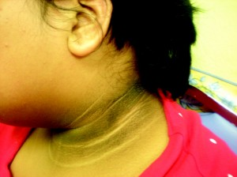
Other types of Diabetes mellitus
Type II diabetes
Associated with obesity
Genetic component, type II > type I
no single defect
Presence of acanthosis nigricans – insulin resistance

